Slide 1



Welcome
Group M

Slide 2
Exploratory Data Analysis of Apps in the Google Play Store

Slide 3
Author
MD. Shahneaj 152392004 39th Batch, CSE
City University codersrv@gmail.com

Slide 4

supervisor
Z. M. Tarek Shahriar Senior Lecturer
CSE Department
City University

Slide 5
Abstract
Mobile app distribution platform such as Google play store gets flooded with several thousands of new apps everyday with many more thousands of developers working independently or in a team to make them successful. With immense competition from all over the globe, it is imperative for a developer to know whether he is proceeding in the right direction. Unlike making a movie where presence of popular celebrities raise the probability of success even before the movie is released, it is not the case with developing apps. Since most Play Store apps are free, the revenue model is quite unknown and unavailable as to how the in-app purchases, in-app adverts and subscriptions contribute to the success of an app. Thus, an app’s success is usually determined by the number of installs and the user ratings that it has received over its lifetime rather than the revenue it generated. In this thesis, on a smaller scale, we have tried to perform exploratory data analysis to dive deeper into the Google Play Store data that we collected, discovering relationships with specific features such as how the number of words in an app name for instance, affect installs, in order to use them to find out which apps are more likely to succeed. Using these extracted features and the recent sentiment of usersi have predicted the "success" of an app soon after it is launched into the Google Play Store.

Slide 6
Thesis Outline
Chapter 1: Contains a brief overview of the research, the estimated goal and how my work can help the developers.
Chapter 2: Discussion of the literature review and background study of the thesis, including detailed description of the algorithms i used in my research.
Chapter 3: Description of the process of collecting data, data processing and description of the corresponding features.
Chapter 4: Discoveries about the correlation between the features that i found by performing EDA with visual representations.
Chapter 5: Definition of the success parameter that i proposed as my target class and the results of each model used.
Chapter 6: Conclusion and proposed future work for the system.

Slide 7
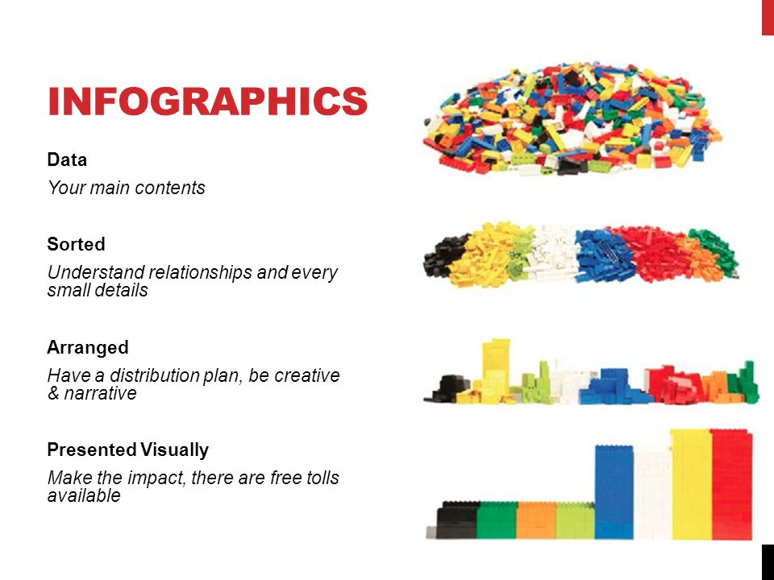

EDA
In Statistics, exploratory data analysis (EDA) is an approach to analyze datasets to summarize their main characteristics, often with visual methods.
Exploratory data analysis was promoted by John Tukey to encourage statisticians to explore the data, and possibly formulate hypotheses that could lead to new data collection and experiments.

Slide 8


Problem Statement
The expansion of smart phones is driving the fast development of mobile app stores. Currently, the two largest global platforms for app distribution are Apple’s App Store (for iOS users) and Google play store (official app store for the Android OS). For my research, i have picked Google play store and did a thorough analysis of its features that were available to me for predicting the success of a particular app.
Success is a thing that does not come to one so easily and for that, i analyzed the features of Google play store and came to a conclusion that will help developers to understand their app success rate using my proposed success parameters.

Slide 9
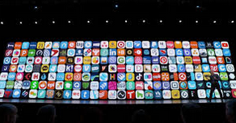


Motivation
Mobile App Industry is booming in a significant way and thus this is giving rise to more competition among the developing community those who create applications.
Many Researchers did research on topics like predicting store rating, sentiment rating, version rating, and many other analyses have been done previously using the data from Google Play Store, however, very few types of research have been conducted based on the topic i have chosen, therefore, i found this topic more convincing for my research work and proceeded with this.

Slide 10
algorithms
Random Forest is a tree-based algorithm which involves building several trees (decision trees), then combining their output to improve generalization ability of the model. The method of combining trees is known as an ensemble method. Ensembling is nothing but a combination of weak learners (individual trees) to produce a strong learner.
XGBoost is another ensemble learning method. As it is almost never sufficient to rely upon the results of just one model, it combines the predictive powers of multiple learners to reach a conclusion.
The k-nearest neighbor (k-NN) algorithm is one of the data mining techniques considered to be among the top 10 techniques for data mining.
Support Vector Machine(SVM)

Slide 11
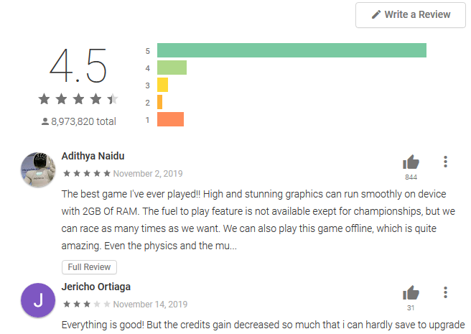

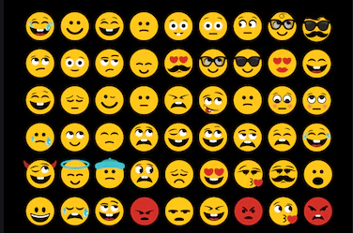

Sentiment Analysis
Sentiment analysis is the measurement of favorable, unfavorable and neutral language. It can evaluate how a person feels by their emotions, opinions and attitudes. It can also be referred to as opinion mining. It basically examines the problem of studying texts, like posts and reviews, uploaded by users on various platforms, forums and electronic businesses, regarding the opinions they have about a product, service, event, person or idea by extracting the subjective information of the source material.

Slide 12
EDA Performed for data visualization
I have analyzed sample data and visualized data through generating graphs.
Criteria:
Category vs App
Category vs Installs
Installs Correlation
App Name
Content Rating
Review Analysis

Slide 13
results
Random Forests
XGBoost Classifier
K-Nearest Neighbour
Support Vector Machine
I used two ensemble learning methods and two machine learning algorithms- XGBoost, Random Forest, KNN and SVM and got the highest accuracy using XGBoost. After comparing all the accuracies by using different algorithms, i performed voting ensemble to get a better accuracy than each individual methods could achieve alone.

Slide 14






tools
Anaconda IDE
Jupiter notebook
Python panda library
Python numpy library
Python seaborn library
Python matplotlib library
For the EDA part I used various Python Data visualization libraries and for predicting the success rate, I used two ensemble learning methods and two machine learning algorithms- XGBoost, Random Forest, KNN and SVM.

Slide 15
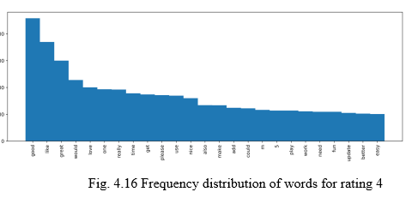
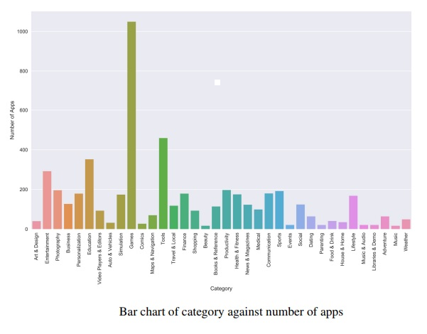
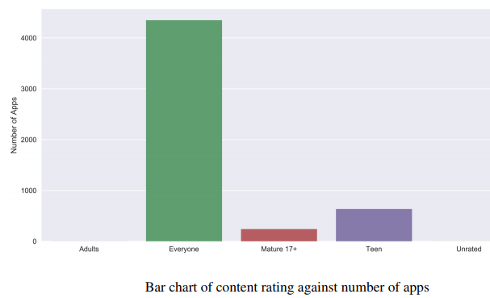
Bar charts

Slide 16
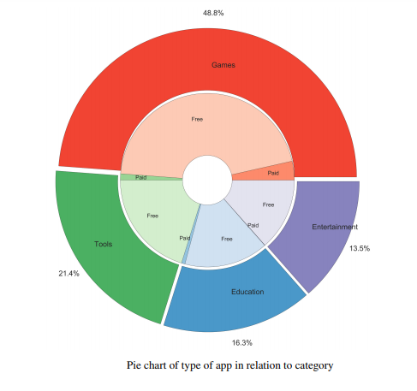
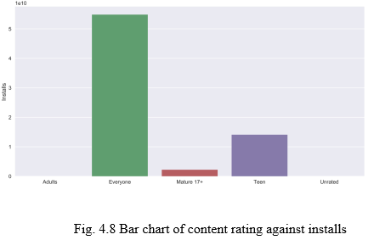
Pie chart & Bar chart
Discoveries about the correlation between the features that i found by performing EDA with visual representations
Pie Chart
Bar Chart
Heat map

Slide 17
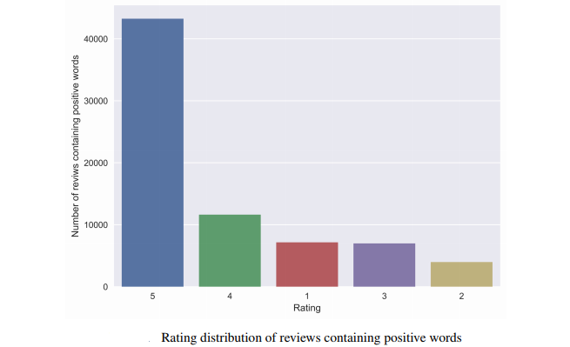
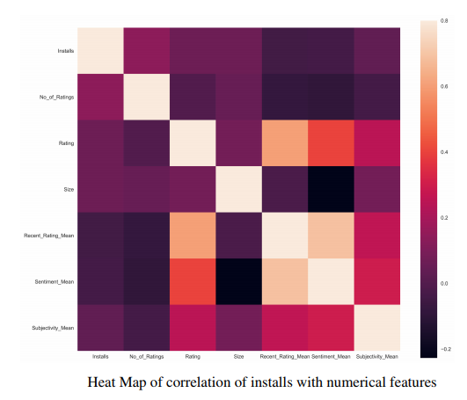
Bar chart & Heat Map

Slide 18
conclusion
The Google Play Store is the largest app market in the world. It generates more than double the downloads of the Apple App Store, but makes only half the money as the App Store. So, I scraped data from the Play Store to conduct research on it. I also defined a success parameter for an app based on the number of installs, distribution of ratings 4 and 5 relative to the overall number of ratings and installs to rating ratio. Using features other than the ones used to create that parameter, i created a model that predicts it with 82.92% accuracy.

Slide 19


